Slide 1
Small Claims Court - Case 2 Vocabulary
Learning is fun
A presentation by: Kenneth Joe Galloway CEO - Knowledge, Growth & Support, Ltd.
kjg@kg-support.com www.kennethjoe.com
Small Claims Court for School - Case 2

Slide 2
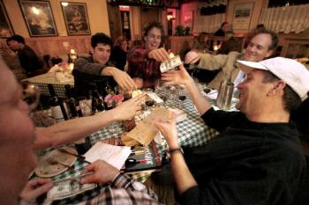
Go Dutch
Share the cost of something, especially a meal, equally.
Small Claims Court for School - Case 2

Slide 3
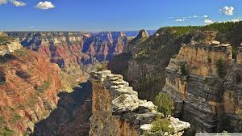
Grand Canyon
The Grand Canyon, is a steep-sided canyon carved by the Colorado River in the United States in the state of Arizona.
Small Claims Court for School - Case 2

Slide 4
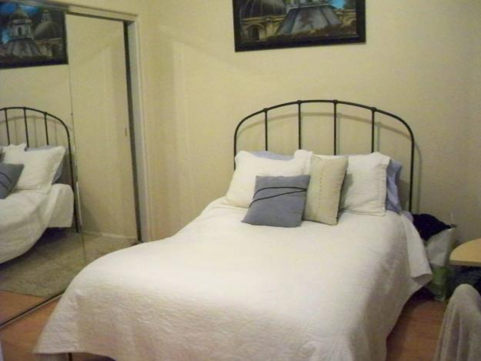
Lodging
ˈläjiNG/
noun
noun: lodging
a place in which someone lives or stays temporarily
"they found a cheap lodging in a backstreet"
a room or rooms rented out to someone, usually in the same residence as the owner.
synonyms:accommodations, rooms, chambers, living quarters, place to stay, a roof over one's head, housing, shelter;
Small Claims Court for School - Case 2

Slide 5
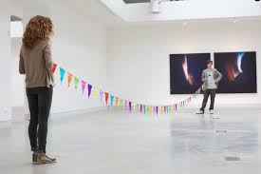
Uphold the end of a bargain
Bargain
ˈbärgən/
noun
noun: bargain; plural noun: bargains
an agreement between two or more parties as to what each party will do for the other.
Commonly used when there is an agreement between two people, and one person has done what they are supposed to, while the other still needs to uphold his end of the bargain.
Small Claims Court for School - Case 2

Slide 6
Offered
ˈôfər,ˈäfər/
verb
past tense: offered; past participle: offered
present or proffer (something) for (someone) to accept or reject as so desired.
"may I offer you a drink?"
synonyms: put forward, proffer, provide, give,
"he offered $200”
express readiness or the intention to do something for or on behalf of someone.
"he offered to fix the gate"
synonyms: volunteer, volunteer one's services
make available for sale.
"the product is offered at a very competitive price"
synonyms: put up for sale
Small Claims Court for School - Case 2

Slide 7
Expenses
/ikˈspens/
Noun
The cost required for something; the money spent on something.
"we had ordered suits at great expense"
synonyms:cost, price,
"the expense of entertaining"
The costs incurred in the performance of one's job or a specific task, especially one undertaken for another person.
plural noun: expenses
"his hotel and travel expenses"
a thing on which one is required to spend money.
Small Claims Court for School - Case 2

Slide 8
Pain killers
pain·kil·ler
ˈpānˌkilər/
Noun
A drug or medicine for relieving pain.
Small Claims Court for School - Case 2

Slide 9
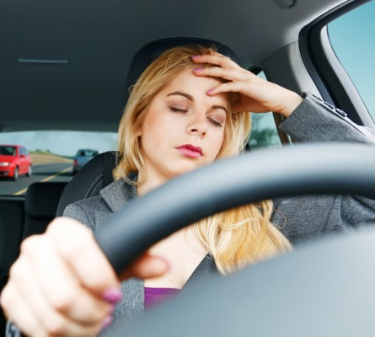
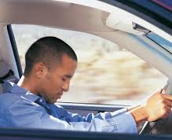
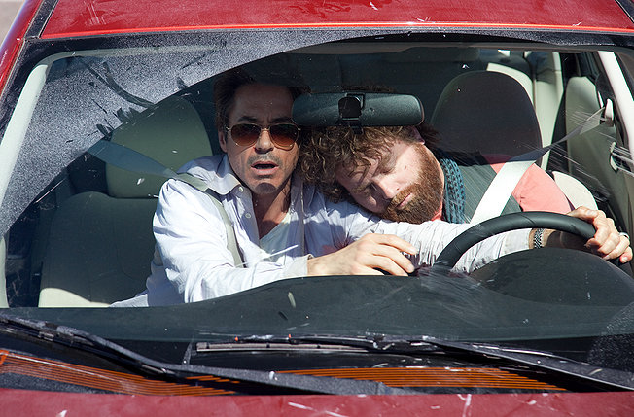
Falling asleep at the wheel
Falling asleep while driving
Small Claims Court for School - Case 2

Slide 10
Entitled
en·ti·tle
verb
Give (someone) a legal right or a just claim to receive or do something.
"employees are normally entitled to severance pay"
synonyms:qualify, make eligible, authorize, allow, permit; Moreenable, empower
"this pass entitles you to visit the museum”
Give (something, especially a text or work of art) a particular title.
"an article entitled “The Harried Society.””
Give (someone) a specified title expressing their rank, office, or character.
"they entitled him King"
Commonly used to describe people who think they are above others, deserve more.
Small Claims Court for School - Case 2

Slide 11
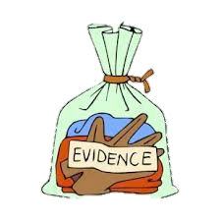
Based on the evidence
Based on the evidence-your fingerprints on the knife, his blood on your gloves- it seems
that you are the murderer.
Small Claims Court for School - Case 2

